Slide 1


DS1108 - Web Programming I
H.M.C. Nirmani
Lecturer (Probationary)
Department of Software Engineering
Faculty of Computing
Sabaragamuwa University of Sri Lanka

Slide 2
Session 02 - I
World Wide Web (Web)

Slide 3
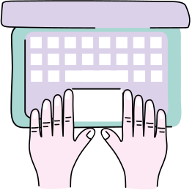
Outline
1
World Wide Web (Web)
2
Evolution of Web
Web 1.0
Web 2.0
The difference between Web 1.0 & Web 2.0
Web 3.0
Web 4.0

Slide 4

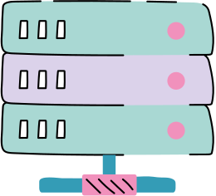
Intended Learning Outcomes
Upon the completion of this session the students should be able to:
Describe World Wide Web.
Discuss the evolution of web and distinguish among each.

Slide 5
World Wide Web

Slide 6
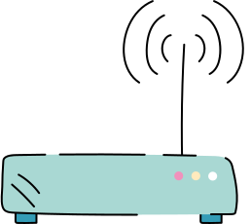
Web (World Wide Web)
The web is a way of accessing information over the medium of the internet.
The web is an information-sharing model that is built on top of the internet.
It has a collection of worldwide electronic documents, where each electronic document is called a web page.
This helps people share and find information easily, using links that connect different pages together.
The web allow us to browse websites, watch videos, shop online, connect with others around the world through computers and phones.

Slide 7
Web (World Wide Web)
Advantages of Web:
Can access for vast amount of information available on any topic.
Easily can access for information from anywhere with an internet connection.
Can efficiently collaborate using tools like google docs, slack, and GitHub.
Can access for global entertainment content.

Slide 8
Web (World Wide Web)
Disadvantages of Web:
Security risk in sharing sensitive and financial information online.
Access for unverified and inaccurate information.
Exposes to hacking, data theft, phishing scams and malicious software.
Can lead to addictions, social isolation and depression.
A gap between different socioeconomic groups as everyone has no equal access.

Slide 9
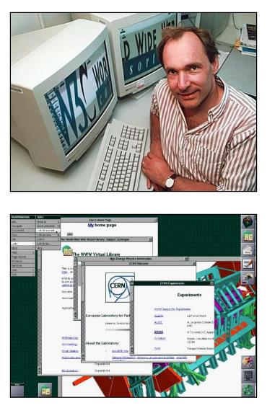
Web (World Wide Web)
Brief history of Web:
The inventor of the world wide web is Tim Berners-Lee
He worked along with colleagues to combine available technologies and data networks to create a user friendly system for global communication and information sharing.

Slide 10
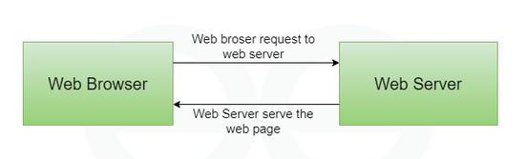
Web (World Wide Web)
How Web works?
A browser is used to access web pages.
The way of web operates as a client-server architecture

Slide 11

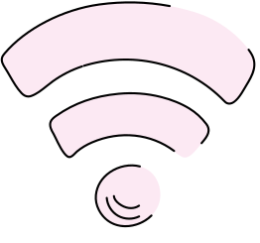
Activity
Distinguish between WWW and the Internet.

Slide 12
Evolution of Web

Slide 13
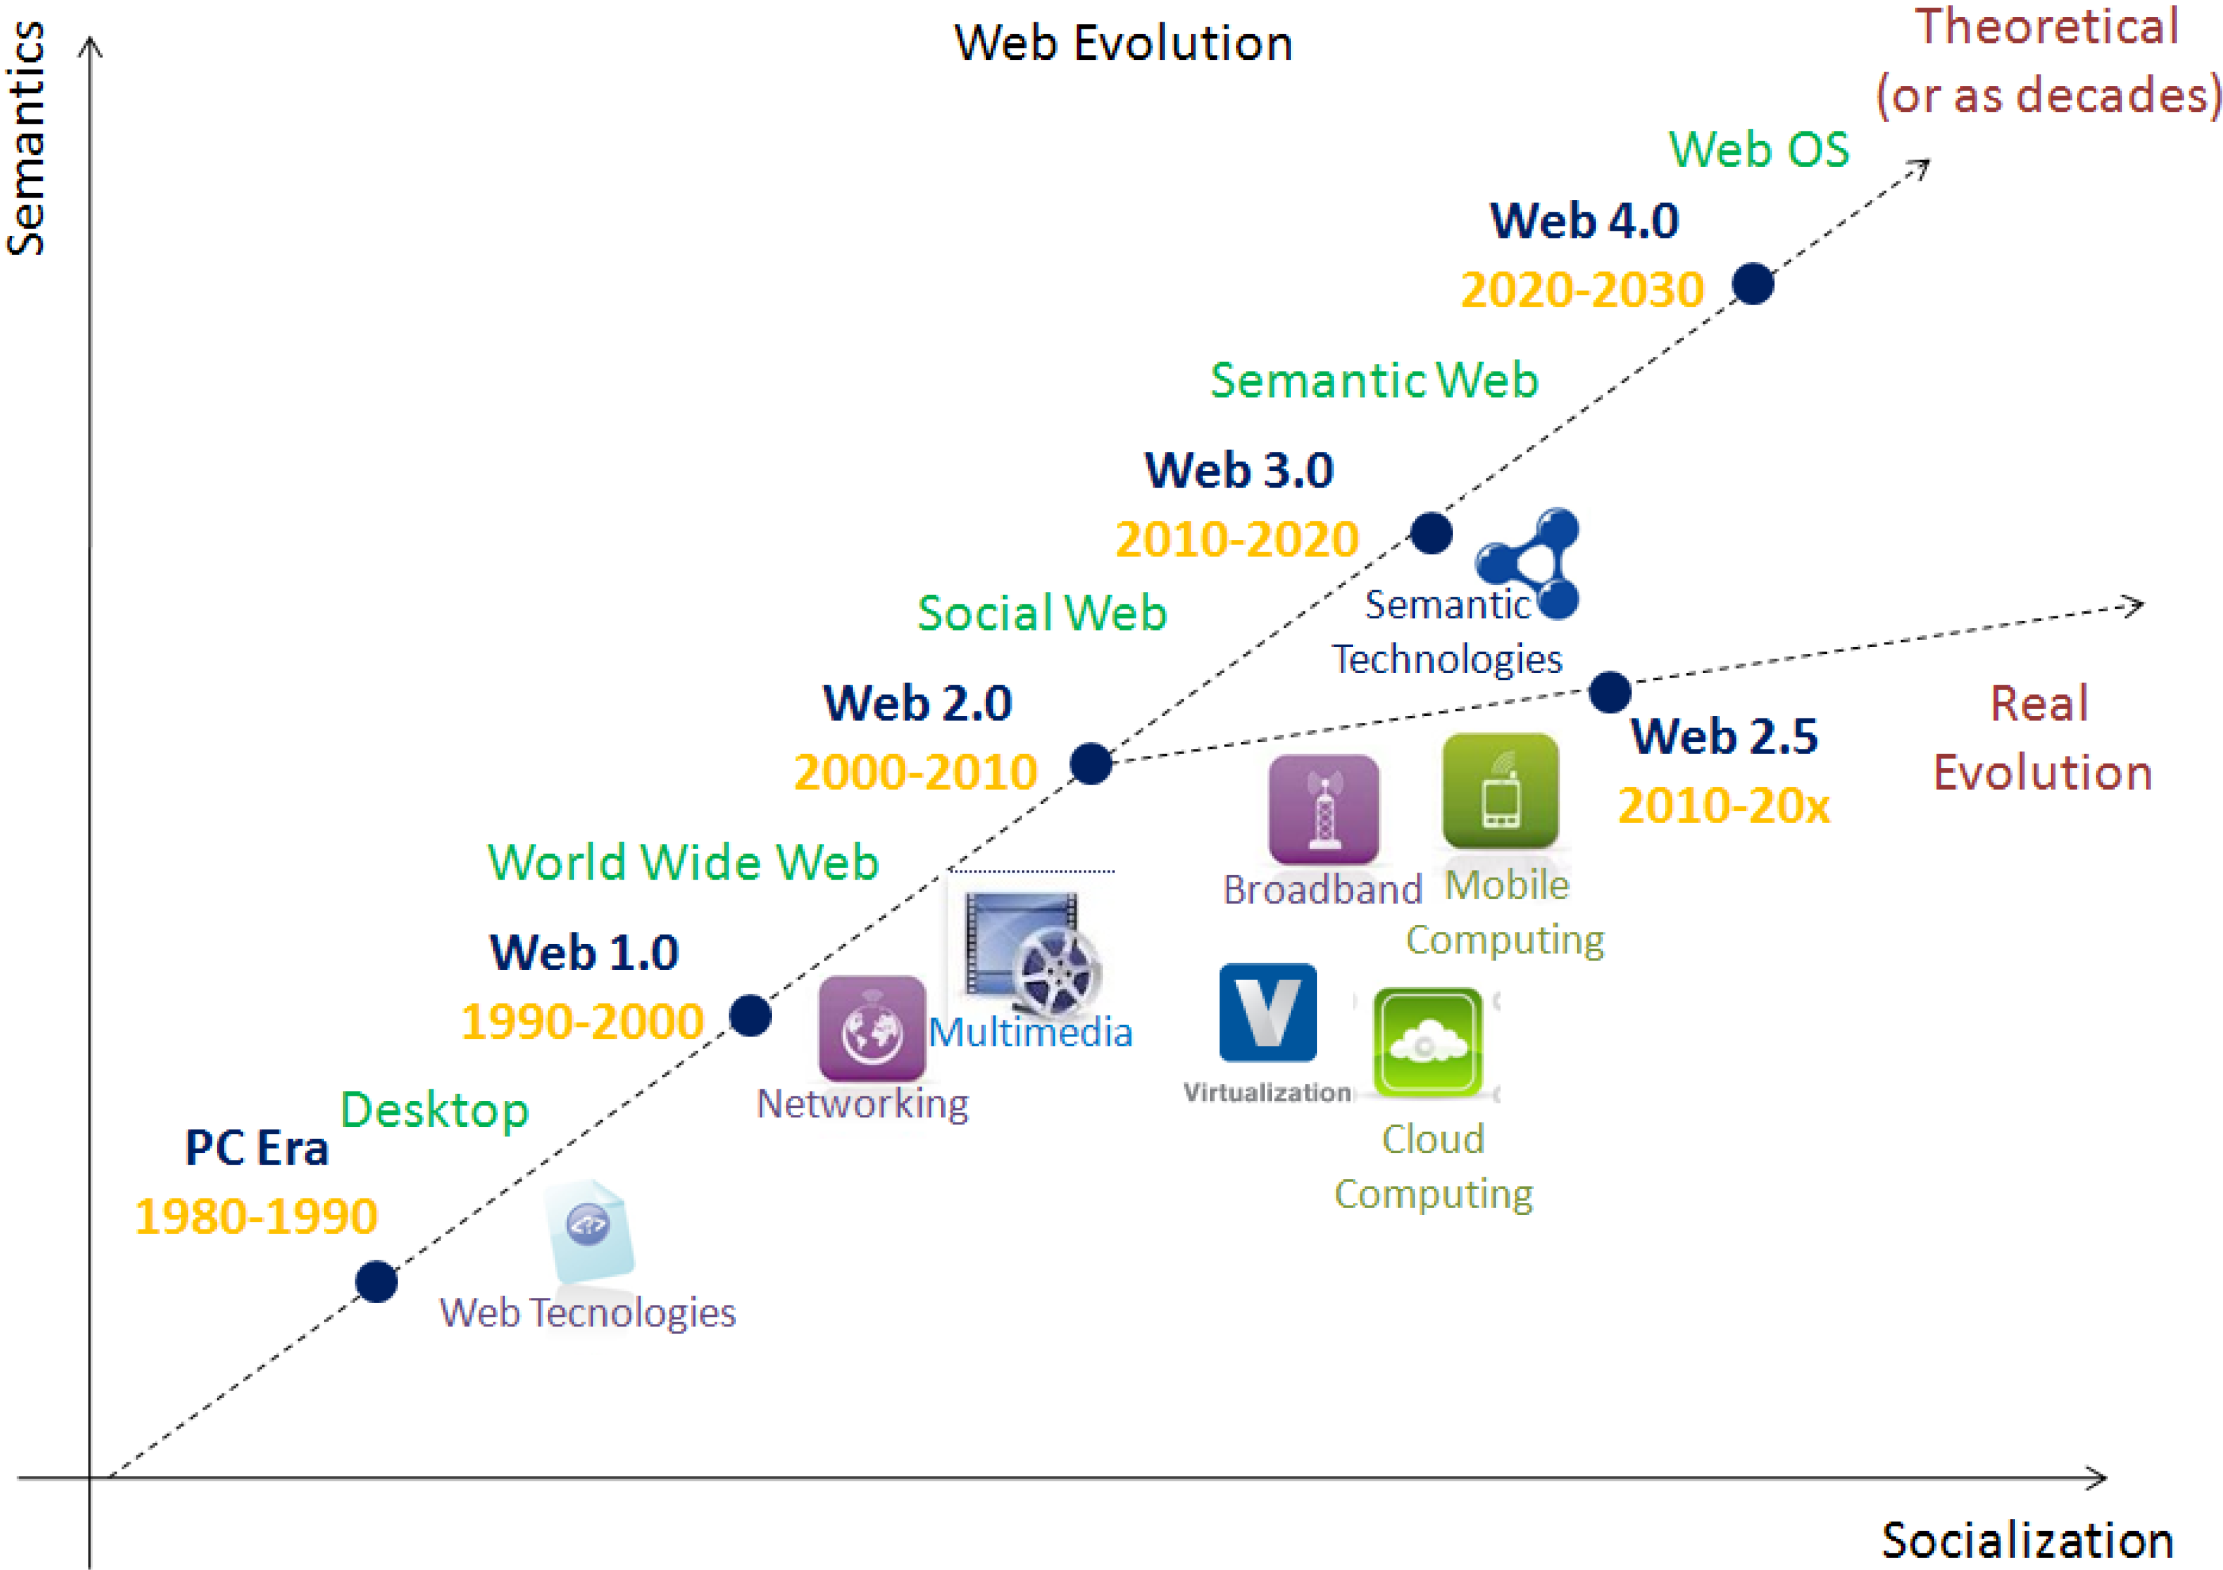
Evolution of Web

Slide 14
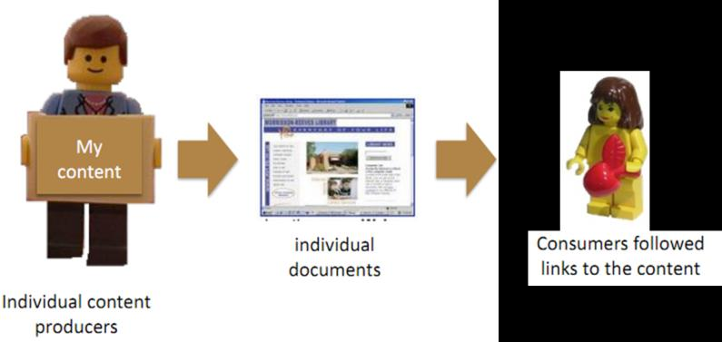
Web 1.0
It was widely used between 1990 and 2000, and it's still used beside web 2.0 in almost all we sites.
The main feature of this were hyperlinking and bookmarking of the web pages.
This was one-way broadcasting. There were no flow or communication between consumer and the producer of the information.
Example:
Static web sites

Slide 15
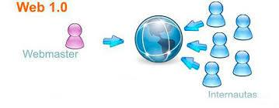
Web 1.0
Technologies developed:
File and Web servers
Content and Enterprise portals
Search engines (AltaVista, Yahoo)
E-mail (Yahoo, Hotmail)
P2P file sharing (Napster, BitTorrent)
Disadvantages:
Read only web
Keyword based search
Lack of standards
Limited user interaction
No real time updates

Slide 16
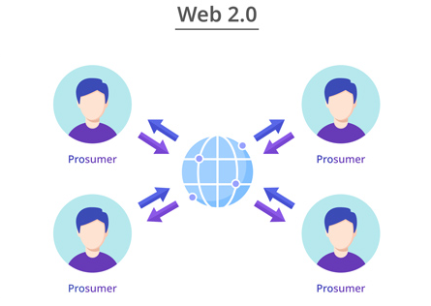
Web 2.0
Web 2.0, is often called as "Social Web".
It was widely used between 2000 and 2010 that brought interactive and social platforms.
It was possible the users to collaborate and share information online. The users became active participants.
This include user generate content, blogs, wikis, social media and web applications.

Slide 17
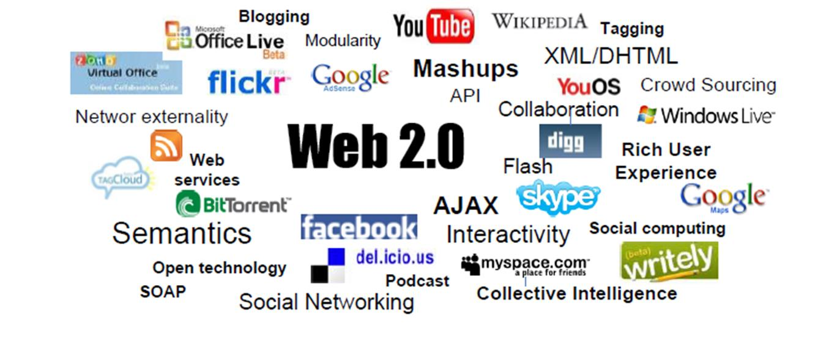
Web 2.0
Web 2.0 Space
It contains with technological components like AJAX, XML/DHTML etc.
It contains principles as participation, collective intelligence and rich user experience.
It contains applications and tools as Wikipedia, mashups etc.

Slide 18
Web 2.0
Technologies and Applications:
User generated content (YouTube, Flickr)
Social bookmarking and tagging (Digg)
Social networking sites (Facebook)
Blogs
Wikis
AJAX
APIs
Etc.

Slide 19
Web 2.0
Opportunities:
Enhance collaboration both internally and with external partners using shared platforms and tools.
Peer-to-peer support: users help each other, create communities and forums for knowledge sharing and problem solving.
Companies can built online communities.
Any user can become a content creator, blog writer, video generator etc.
Individuals can create and manage their own digital identity.

Slide 20
Web 2.0
Challenges:
Privacy issues
Anonymous posting
Possibility for change the content of others
Publishing of fake news, biased content, and unreliable content
Plagiarism and copyright infringement
Information overload

Slide 21
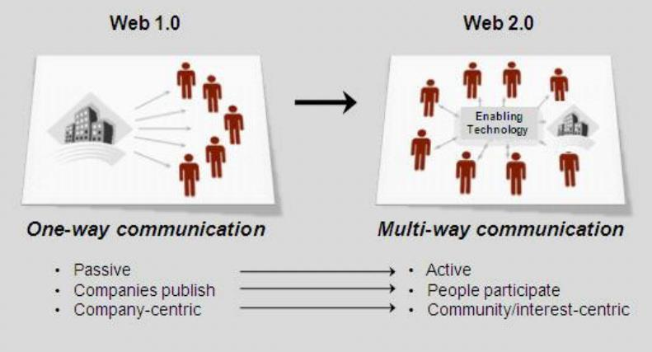
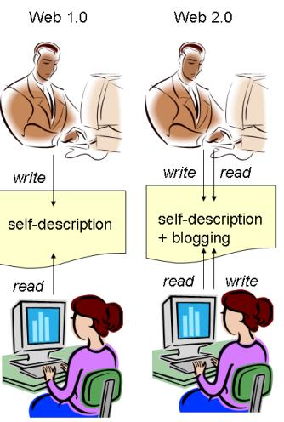
The difference between Web 1.0 & Web 2.0

Slide 22
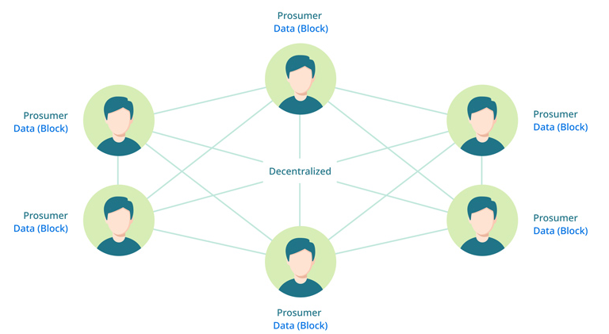
Web 3.0
It was widely used between 2010 and 2020 focused on Semantic Web, that enabling machines to understand data and offer personalized experience.
This provides more personalized and efficient user experience through decentralization.
This allow users more control over their data and more seamless interactions with web.
Here, the users actively participate in the development of web than being passive contributors.

Slide 23
Web 3.0
Features:
Open: the web 3.0 solutions are open source as they are developed with the support of open source community and developers.
Permission less: the users and the service providers do not need permissions from centralized institutions to access or interact with them.
Accessibility: this aims to make internet accessible to anyone, anytime and from any location.
Semantic web: make the web smarter by giving data meaning and context.

Slide 24
Web 3.0
Technology behind web 3.0:
Semantic web: allow the machines to understand and interpret the meaning of data on the internet.
3D graphic: allow users to access the internet through immersive 3D digital world (VR, AR).
Blockchain
Artificial intelligence
Edge computing

Slide 25
Web 3.0
Advantages:
Control over data ownership
Freedom for interactions
Advantages for creators
Better security
Access for data at anytime, anyplace

Slide 26
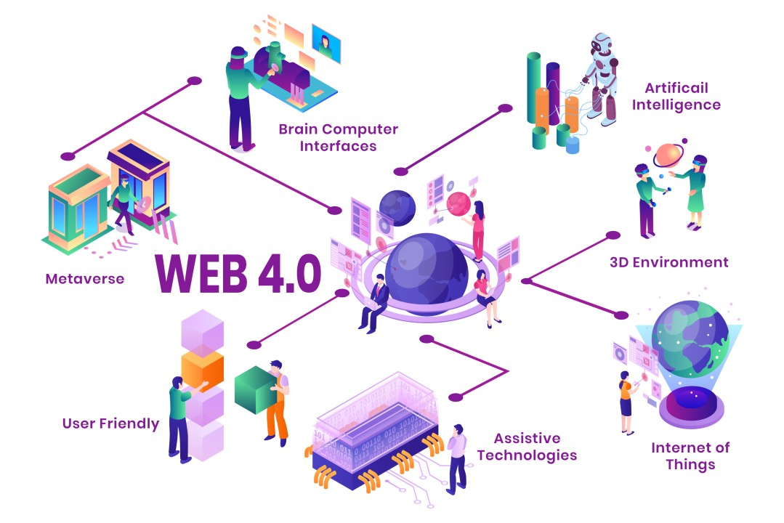
Web 4.0
Looking ahead, the web 4.0 (2020 to 2023) is expected to be a fully intelligent web ecosystem powered by AI and integrated web operating systems.

Slide 27
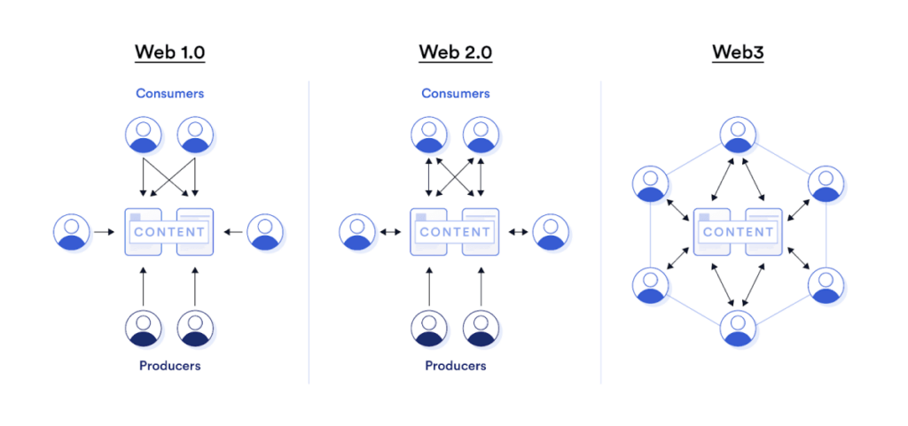
Activity
Distinguish between Web 1.0, Web 2.0 and Web 3.0

Slide 28
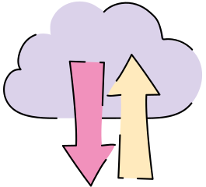

Thank You

